Slide 1
S&R-DRONE: A Compact Search-and-Rescue Drone with a Custom Flight Controller, Motor Driver and ML-Based Victim Detection
PROJECT SYNOPSIS AND PROPOSAL
TEAM:
WALIUL ISLAM NABIL | KHANDAKAR NAFIS HASNAIN RAMI | TANZIM AHAMED | RITU MONY | UMME KULSUM | MD SHAH PARAN | SAAD TALUKDER | MD EHSANUL HOQUE BADHON
PRESENTERS: RITU MONY | UMME KULSUM
GUIDE: DIPTO BISWAS | LECTURER (SENIOR SCALE), DEPARTMENT OF ICE, DAFFODIL INTERNATIONAL UNIVERSITY | ID: 71000292
DEPARTMENT OF INFORMATION AND COMMUNICATION ENGINEERING (ICE) | DAFFODIL INTERNATIONAL UNIVERSITY (DIU) | 13 OCT 2026

Slide 2
Project Overview
SARDRONE in one line: A compact quadcopter for first-response search and rescue. It flies on our own electronics and finds people using machine learning.
What we will build
How it works
Fly: IMU-based flight stabilization.
Sense: Capture camera and thermal data.
Detect: ML-based person detection.
Alert: Notify rescuers when detected.
Compact quadcopter frame (under [500] g)
Custom flight controller (IMU + MCU + PID)
Custom motor driver (3-phase BLDC ESC with protection)
Rescue payload (camera + thermal sensor)
ML model for automatic person detection
Fly → Sense → Detect → Alert
10 weeks | 8-member team | Hardware + Firmware + ML
Output: working prototype

Slide 3
Introduction, Motivation and Context
Why this project?
Theory we apply → Practice we build
Floods, earthquakes and landslides trap people in hard-to-reach places.
Manual search is slow, risky and costly.
A human operator can miss a victim in long video feeds.
Commercial drones are expensive and closed-source.
Theory | Practice
Quadcopter dynamics, PID control | Stable hover firmware
Sensor fusion (Kalman / complementary filter) | Attitude estimation with IMU
BLDC motor commutation | Custom motor driver
Deep learning (CNN object detection) | Automatic person detection from camera and thermal images
Today: Gap → Objectives → Design → Plan

Slide 4
Existing Solutions, Gap and Our Contribution
Criterion | Commercial drone | Pixhawk (open-source) | SARDRONE
Cost | High | Medium | Low (target)
Size | Large | Medium | Compact
Customizable | No | Partly | Fully
Hardware design | Closed | Standard board | Our own design
Victim detection | Manual or costly add-on | Not included | Built-in ML model
Our contribution: A low-cost drone with our own flight controller and motor driver, plus an ML model that detects people automatically, with open design files and dataset for other students.

Slide 5
Objectives and Goals
Objectives
Measurable goals
Design a compact quadcopter frame.
Develop a custom flight controller (IMU + MCU + PID).
Develop a custom motor driver (ESC).
Add camera and thermal sensor for live video.
Train and deploy an ML model for automatic person detection.
Test stability, flight time and detection accuracy.
Weight: under [500] g
Flight time: [10-15] min
Stable hover: within [±___] cm
Detection accuracy: above [85]% (precision and recall)
Detection speed: at least [10] frames per second
Out of scope
Fully autonomous flight and auto path planning are future work.

Slide 6
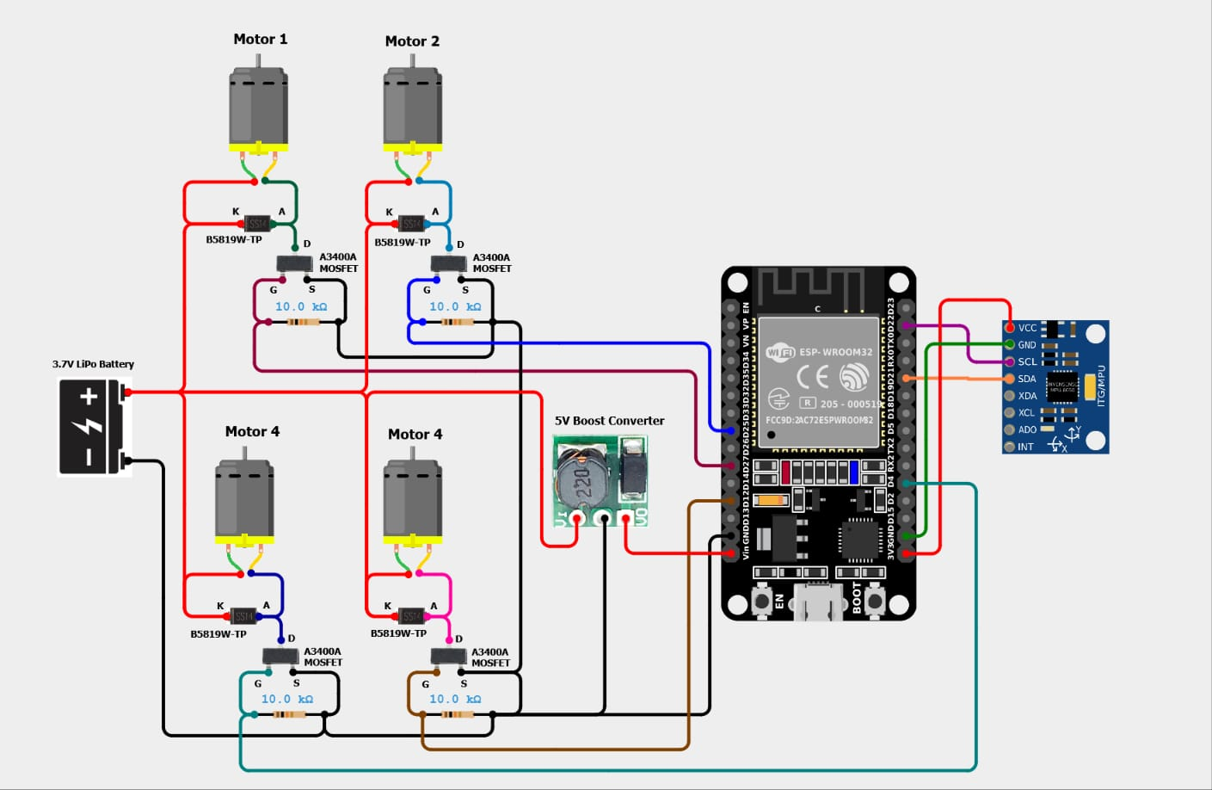
System Architecture
Three coordinated chains connect the aircraft, payload and ground station.

Slide 7
Flight Controller, Motor Driver and ML Detection Design
Flight controller
Motor driver
ML detection
MCU: [STM32 / ESP32]
6-axis IMU, barometer, GPS
Sensor fusion → cascaded PID
Failsafe, return-to-home
Theory: PID + complementary filter
3-phase MOSFET bridge + gate driver
Sensorless back-EMF commutation
PWM speed control
Over-current and over-temperature protection
Theory: 6-step BLDC commutation
Dataset: public datasets (HERIDAL, VisDrone, FLIR thermal) + our own mock-test images
Model: lightweight CNN (YOLO-Nano / MobileNet-SSD)
Train on laptop / Google Colab
Deploy on companion computer (Raspberry Pi Zero 2 W or similar)
Theory: CNN, transfer learning

Slide 8
Activities, Team and Responsibilities
Member | Responsibility
1 [ Nabil , Rami] | Team lead, integration, testing
2 [ Nabil, Ritu] | Frame design (CAD, 3D print)
3 [ Nabil, Kulsum] | Flight controller hardware (schematic, PCB)
4 [ Nabil, Kulsum] | Flight controller firmware (sensor fusion, PID)
5 [ Nabil, Poran] | Motor driver hardware (MOSFET bridge, protection)
6 [ Nabil, Badon ] | Motor driver firmware (commutation, PWM)
7 [ Nabil, Rami] | Camera, thermal sensor, video link
8 [Tanzim, Rami ] | ML model (dataset, training, deployment)
9 [ Tanzim, Ritu, Saad] | Documentation and ground station
8 students | Guide: DIPTO BISWAS | Weekly review meeting

Slide 9
Time Frame
10-WEEK GANTT CHART
Phase | 1 | 2 | 3 | 4 | 5 | 6 | 7 | 8 | 9 | 10
Study, design, simulation
Hardware (frame, PCB)
Firmware
ML: dataset, training, testing
Payload(camera, thermal, video)
Integration and testing
Report and demo
Milestones: Week 2 – Design freeze | Week 4 – Boards ready | Week 7 – First trained model | Week 8 – First flight | Week 10 – Final testing and demo

Slide 10
Final Deliverables, Format, Risks and Budget
Final output
Final format
Risk → Solution
Working drone prototype
Custom flight controller and motor driver PCBs
Trained ML model with dataset and accuracy report
Test report
Project report
Demo video
Design files and code
Live demo: hover and person detection; poster; final slides
PCB error → simulation and design review first
Motor heating → protection circuit
Crash → tethered test, spare parts
Low accuracy or slow model → smaller model, more data, thermal images
Estimated Total Budget: ৳10,000–৳10,500 BDT, covering the frame, motors, battery, PCBs, sensors, companion computer, and spare parts.

Slide 11
Conclusion
Problem: slow and risky search
Context: control theory and machine learning on real hardware
Contribution: custom flight controller, motor driver and ML-based detection
Plan: 10 weeks, 8 members
Outcome: low-cost, customizable rescue drone
Explore Our Project on GitHub ↗ → View Project on GitHub ↗
Thank you. Questions?
What success looks like
Working prototype, reproducible design files and a measurable detection pipeline.

